Slide 1
Excel PivotTables
Excel’s premier analytical tool !
The ideal feature for quickly creating summary information that you can easily manipulate with drag-and-drop techniques to show multiple levels of totals in a variety of layouts.
Presented by: Dennis Taylor

Slide 2
What is a PivotTable?
With a PivotTable, you can display summary information gathered from detailed worksheet data
After creating a PivotTable, you can:
Transpose data fields by flipping row/column displays
Manipulate and alter the table layout in an almost infinite number of ways
Expand/collapse the table to reveal/hide detail
Group data in ways not attainable while working with the original data.
Use a “drill-down” feature that reveals all of the record detail for any PivotTable value
Create a Pivot Chart that is in sync with the PivotTable – change the table and the chart reacts – change the chart and the table reacts.
A PivotTable is distinct and separate from the original data, yet dependent on that data. Any change you make to a PivotTable has no impact on the original data.

Slide 3
Source Data for a PivotTable
Prerequisites
Data for a PivotTable needs to be organized as a list
A single title row on top with unique field headings
Continuous row after row and column after column of data with no empty rows and no empty columns
Data structured as a Table meets all of the requirements above and also simplifies PivotTable updating
Not organized – missing field name, empty row, empty column
Organized – data all together in one solid cluster with field names for each column in the top row

Slide 4
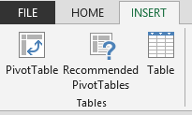
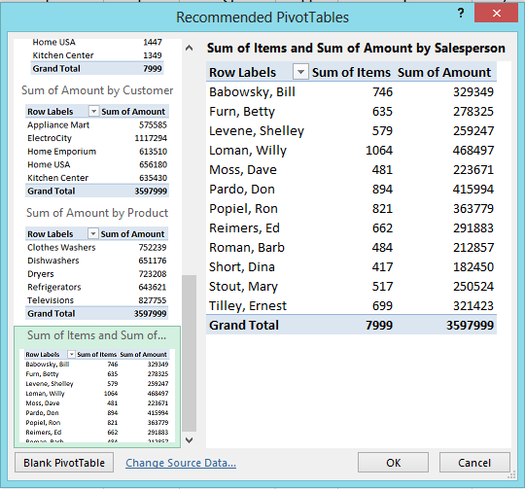
Create a PivotTable – Quick Method
Select any cell within the source data
Click the Insert tab on the Ribbon, then the Recommended PivotTables button in the Tables group
Use the scroll bar in the Recommended PivotTables dialog box to view sample PivotTables
Click one of the selections and then OK

Slide 5
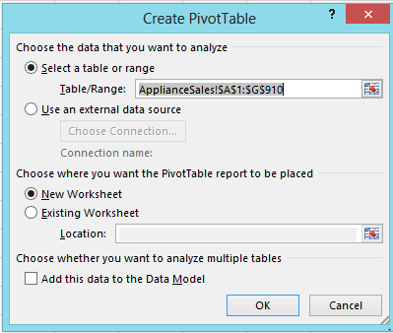
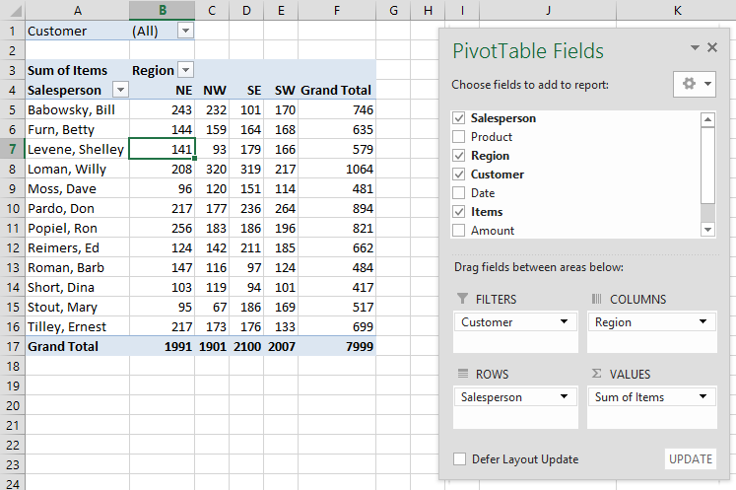
Create a PivotTable – Standard Method
Select any cell within the source data
Click the Insert tab on the Ribbon, then the PivotTable button in the Tables group
In the Create PivotTable dialog box, click OK
Drag fields from PivotTable Fields to these areas:
Rows
Columns
Filters
Values

Slide 6
Drag a Field – “Pivot the Data”
Alter PivotTable layout by dragging fields to different areas
By dragging fields between areas called Rows, Columns, and Filters (“Pivoting” the display), you can determine the best way to display summary information.
Gives you a nearly limitless ability to change displays

Slide 7
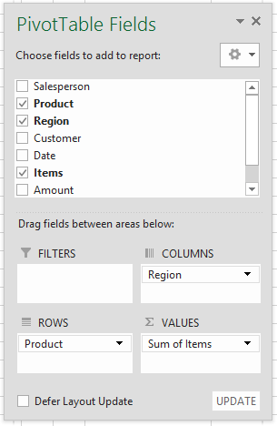
"Pivot" the Data Example
Alter PivotTable layout by dragging fields to different locations
Drag fields between Rows, Columns, and Filters areas to immediately change the layout of the PivotTable.
Example: Reverse the order of the Region and Product
fields for a different view of the data
Drag the field name Region from the Rows area to the Columns area
Drag the field name Product from the Columns area to the Rows area
You can drag field names to different locations on the actual table if desired. On the Analyze tab, click Options (in the PivotTable group); then click the Display tab and click Classic PivotTable layout.

Slide 8
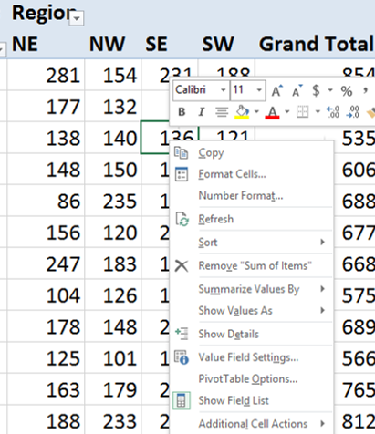
Adjust Numeric Formats
Change the formatting of all numeric data item entries in a PivotTable in one of these ways:
Select a value within the PivotTable and then click the Field Settings button in the Active Field group in the Analyze tab in the ribbon; then click the Number Format button and select from numerous options.
or
Right-click a value within the PivotTable and select Number Format

Slide 9
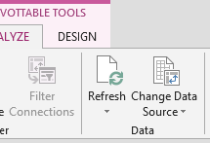
Update a PivotTable
A PivotTable does not immediately reflect changes that occur in the original source data. To insure that a PivotTable is an up-to-date representation of the source data, either press the Refresh button in the Data group on the Analyze tab in the Ribbon, or press Alt+F5.
Create another PivotTable based on the same data
With the active cell in a PivotTable, click the Select button in the Actions group of the Analyze tab in the Ribbon; then click Entire PivotTable
Press Ctrl+c (to copy the PivotTable)
Position the active cell at the location of the new PivotTable and press Ctrl+v (Paste)

Slide 10
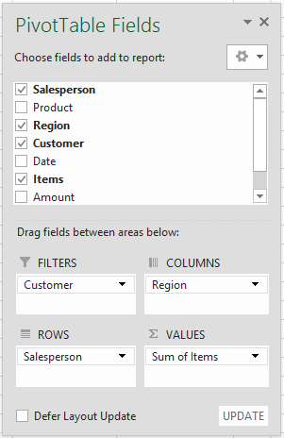
Add/Remove PivotTable fields
You can add and remove fields from a PivotTable to provide more detail or to make the table more compact
Add a field to a PivotTable:
Drag a field name from the PivotTable field list to the Rows, Columns, Filters, or Values areas
Remove a field from a PivotTable:
Un-check the box next to a field name in the PivotTable Field list.

Slide 11
Sort PivotTable data
By field name
After clicking a field item, you can sort:
Re-arrange rows
Select a cell in the Rows area and click the AZ (Sort ascending) button to re-arrange rows in alphabetical order top-down
Re-arrange columns
Select a cell in the Columns area and click the AZ button to re-arrange columns in alphabetical order left-to-right
By data field content
After clicking a numeric cell, you can sort:
Re-arrange rows
Select a value in a Grand Total column and click the ZA (Sort descending) button to re-arrange rows in descending order based on the values in the Grand Total column
Re-arrange columns
Select a value in a Grand Total row and click the ZA button to re-arrange columns in descending order left-to-right based on the values in the Grand Total row

Slide 12
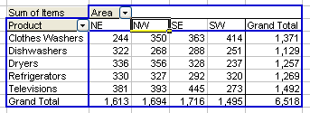
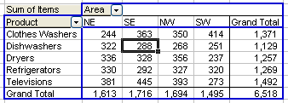
Drag Field Items
Move column item entries left or right
Move row item entries up or down
To move the NW column to the right so that it is adjacent to the SW column:
Click the cell containing NW
Point to its bottom edge and drag rightward, following the i-beam indicator until it appears adjacent and to the left of the SW column
Before
After

Slide 13
Use the Filters
Use the Filters area for these reasons
To quickly move fields out of the way (so that their content is not relevant in the PivotTable)
As a location for fields where you want to be able to choose one, some, or all possible field entries
Filter set to All
Filter set to NE and NW

Slide 14
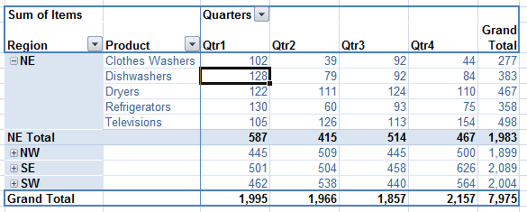
Extract Data with Drill-down
See the detail behind any PivotTable value simply by double-clicking a cell in a PivotTable that contains a value – results are displayed on a new worksheet.
Double-click the Qtr1 Dishwashers cell for the NE Region and immediately get a list (on a new worksheet) of all records that are the source of that entry.

Slide 15
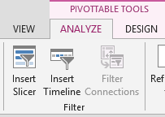
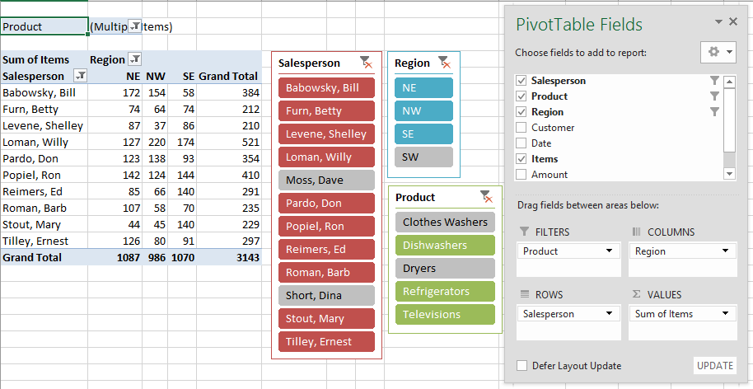
Slicers
Interactive filtering makes it easy to see which field entries are being used (and which ones are not) in a PivotTable.

Slide 16
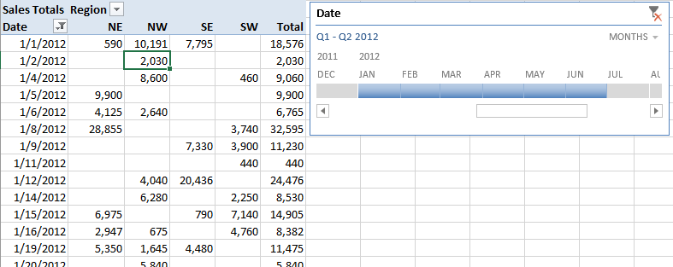
Timeline (new in 2013)
Simplify time-based filtering in a PivotTable
Show consecutive months (or days, quarters, years)

Slide 17
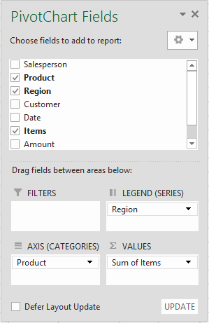
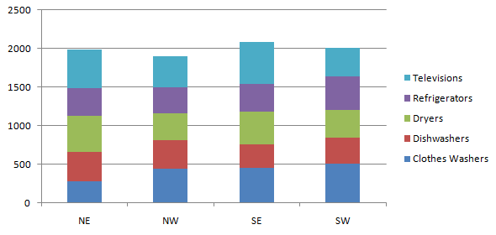
Create a Pivot Chart
Create a Pivot Chart in one of two ways:
Position the active cell within an existing PivotTable and then click one of the Chart Types available in the Charts group of the Insert tab in the Ribbon.
Position the active cell within an existing PivotTable and press Alt+F1 to create a Pivot Chart next to the PivotTable or F11 to create a PivotChart on a new sheet.
Move Pivot Chart Fields
Drag field names to/from these PivotChart axes:
FILTERS – above the chart
LEGEND (SERIES) – right side of the chart
AXIS (CATEGORIES) – bottom of the chart
VALUES – center of the chart

Slide 18
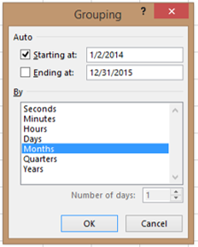
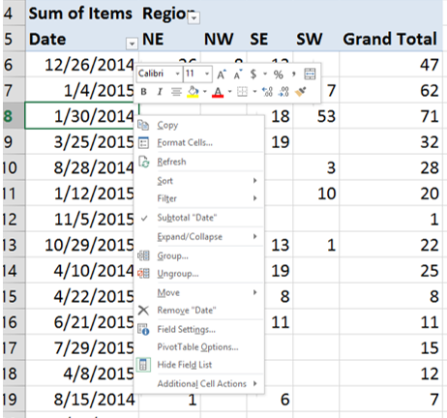
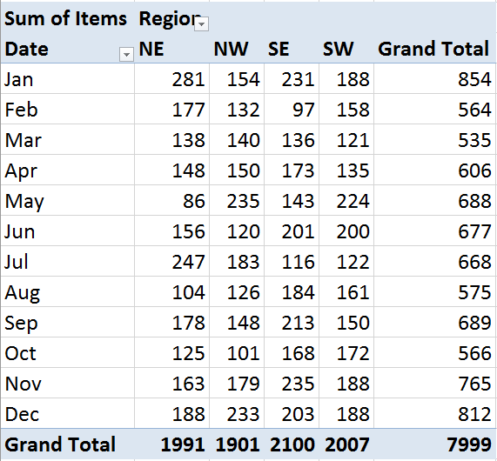
Group Data by Date or Time
Group/Ungroup PivotTable Data
Group data into hierarchical or ad hoc arrangements
Rename grouped items
Hide details in grouped items; reveal hidden details
Quickly summarize detailed date or time data by:
Years
Quarters
Months
Hours
Minutes
Seconds
Right-click a date/time cell (in the Rows or Columns areas) and choose Group to activate the Grouping dialog box.

Slide 19
Collapse/Expand Outer Fields
With two or more fields side by side in either Rows or Columns Areas, the field farthest to the right is an inner field. The other fields are outer fields.
In the Rows area, click the minus sign (-) to the left of an outer field item and the detail of fields to the right becomes hidden and the total of the hidden data is represented on a single row.
If you click the plus sign (+) to the left of a field name, the hidden detail data re-appears.
Click the minus sign next to the regions NW and SW in the Rows area; the PivotTable collapses the detail for these regions to show only their totals

Slide 20
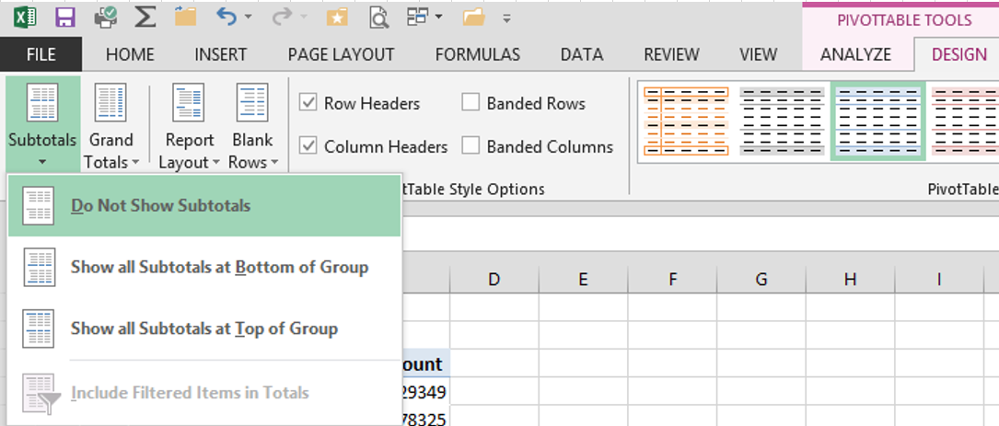
Display Subtotals and Grand Totals
Display Subtotals and choose their locations
Click Do Not Show Subtotals to hide them
Click other options to display subtotals and determine their locations.
Show/Hide Grand Totals (located on the right and/or bottom of a PivotTable)
Right-click any PivotTable cell and select PivotTable Options In the Totals and Filters tab, check/uncheck these options:
Show grand totals for rows
Show grand totals for columns

